Slide 1
What App Should We Make?
Samira Hajimohammadzadeh
Jingchen Liu
Jonathan Nguyen
David Ilugbuhi

Slide 2
Data & Questions
Data: Google Play App Store data - April 2019
Questions:
What are the relationships between each variable of this dataset?
What kinds of apps are the most profitable/popular?
What factors should we consider when making this app?
CSV Link: https://www.kaggle.com/gauthamp10/google-playstore-apps
API Link: https://github.com/gauthamp10/Google_Play_App_Info

Slide 3
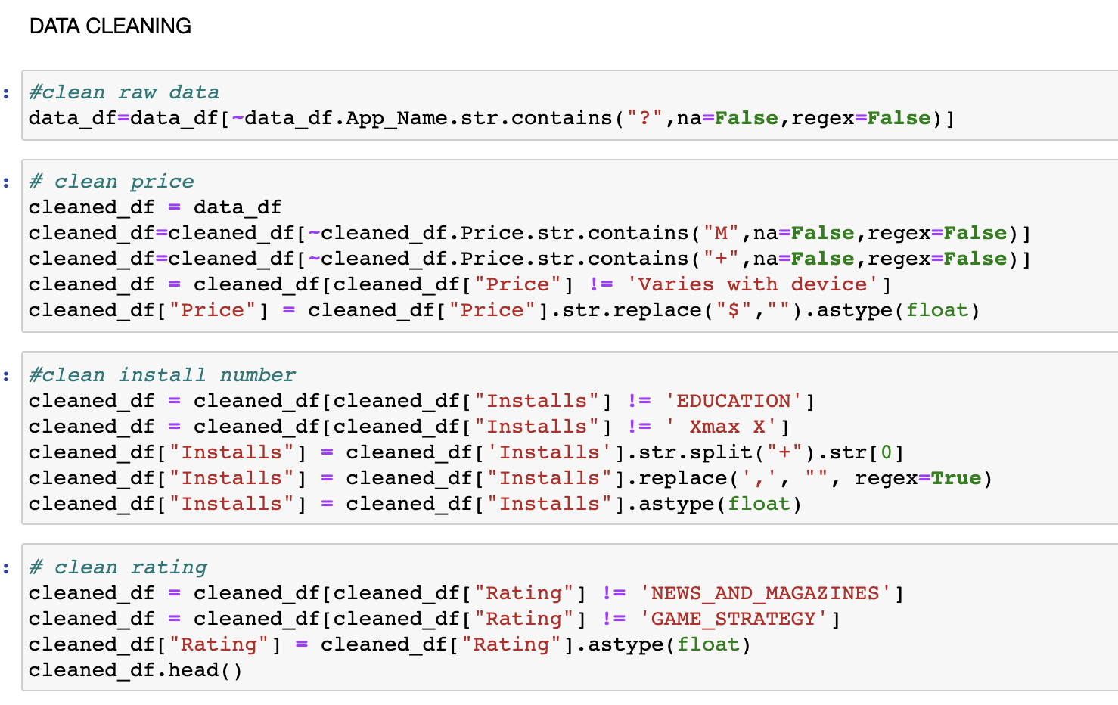
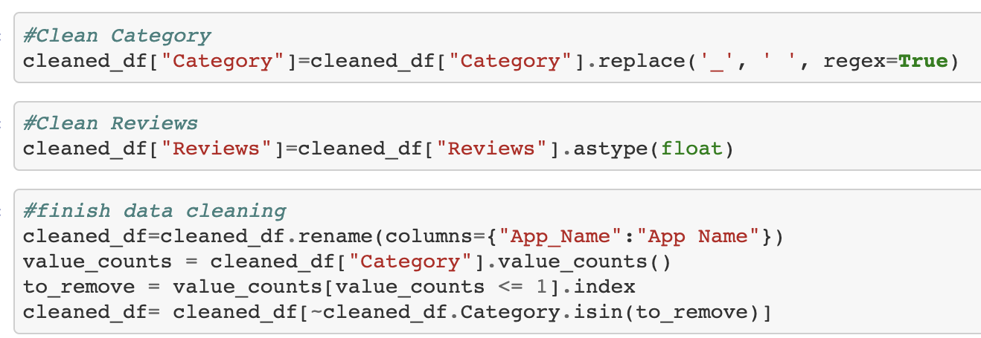
Data Cleaning
Clean App Names
Took out the outliers
Clean extra marks
Convert objects type to float

Slide 4
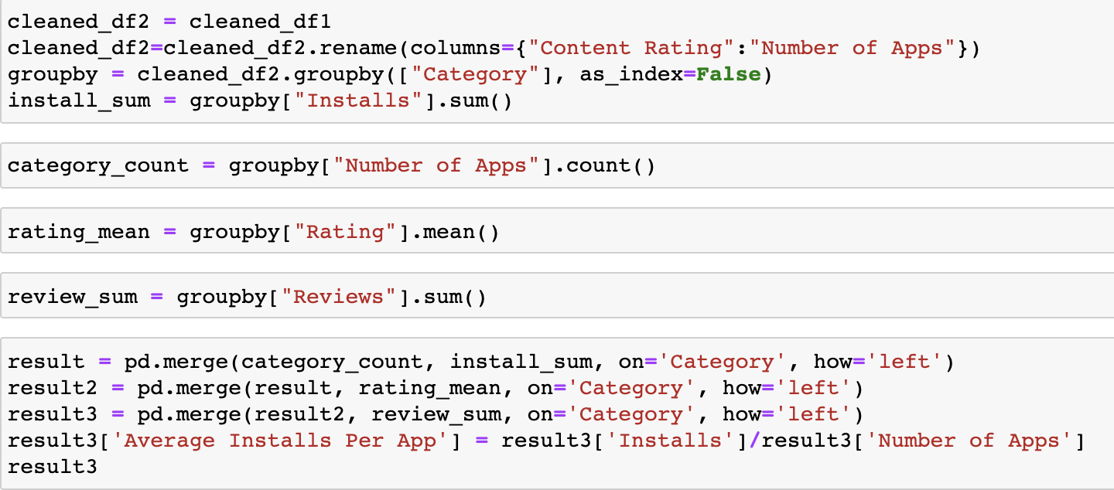
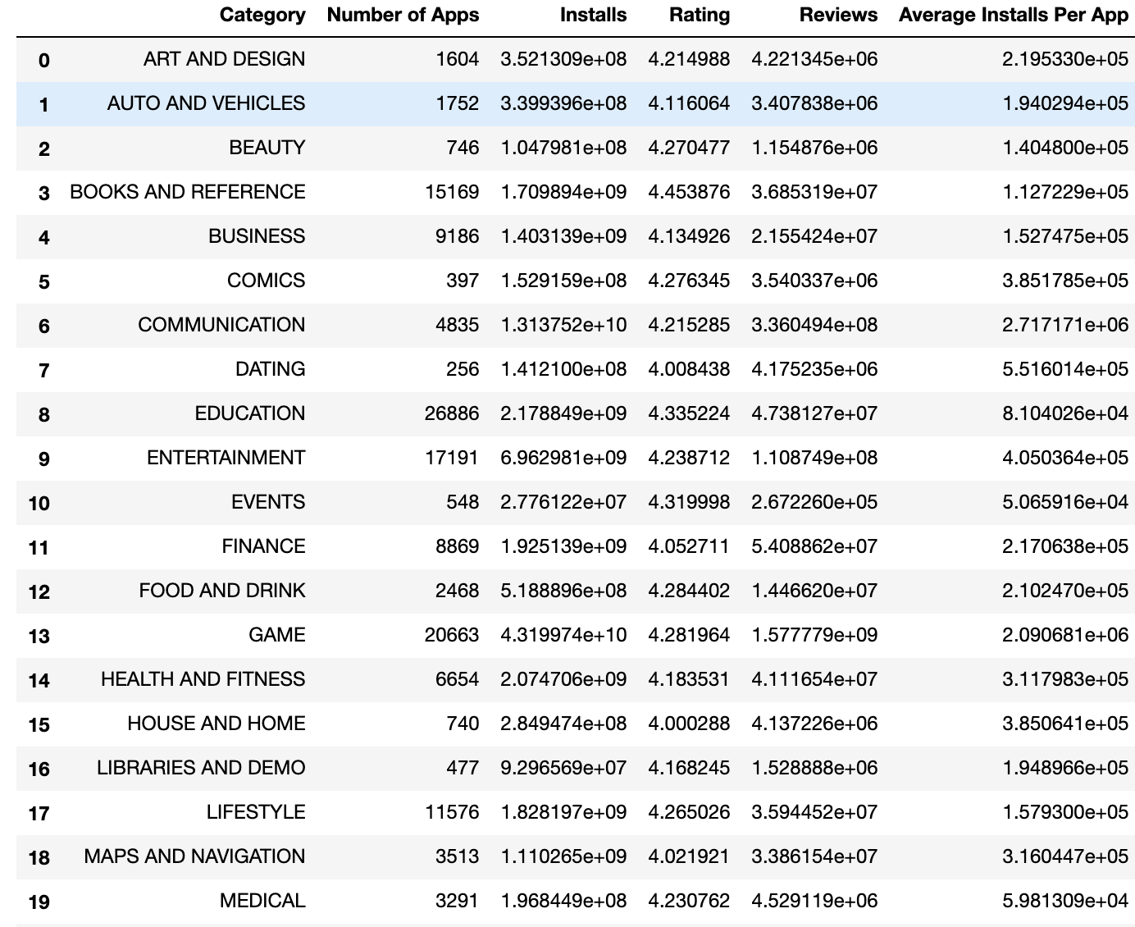
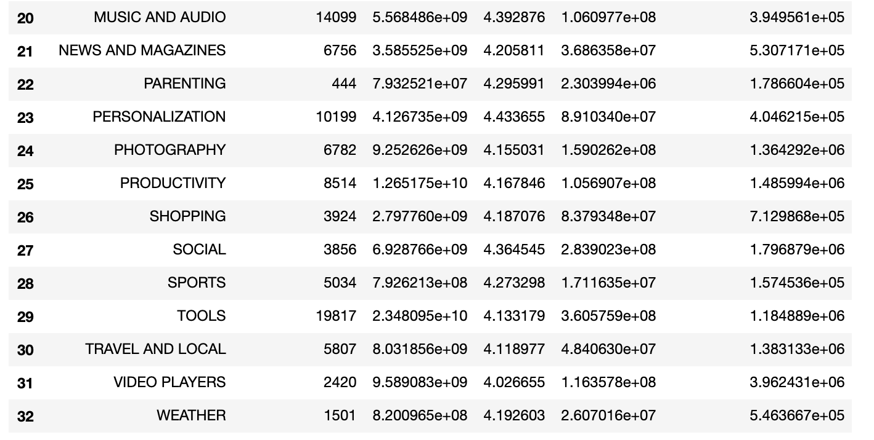
Cleaned Data

Slide 5
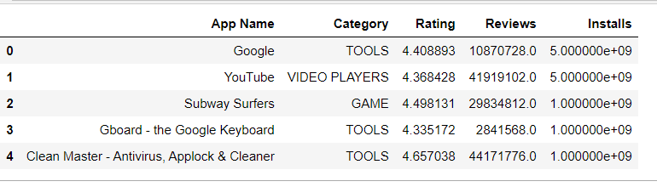
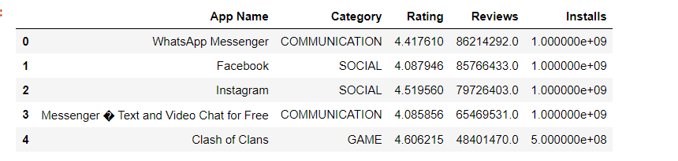
Top 5 Install Apps
Most Reviewed Apps

Slide 6
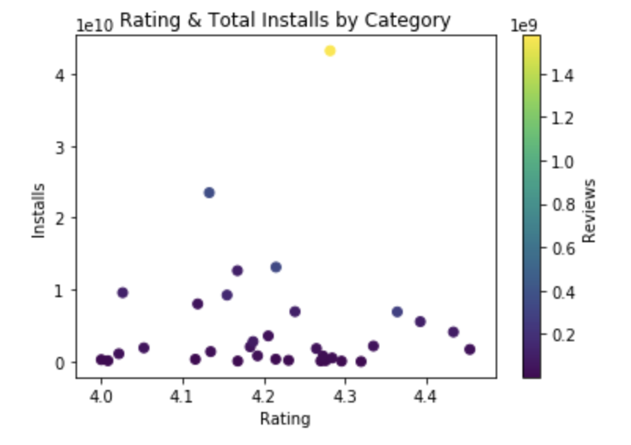
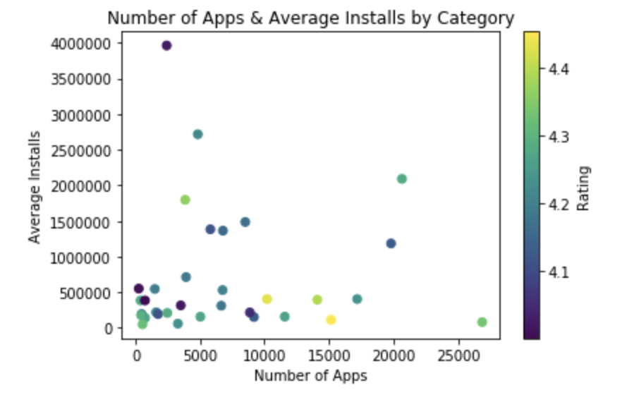
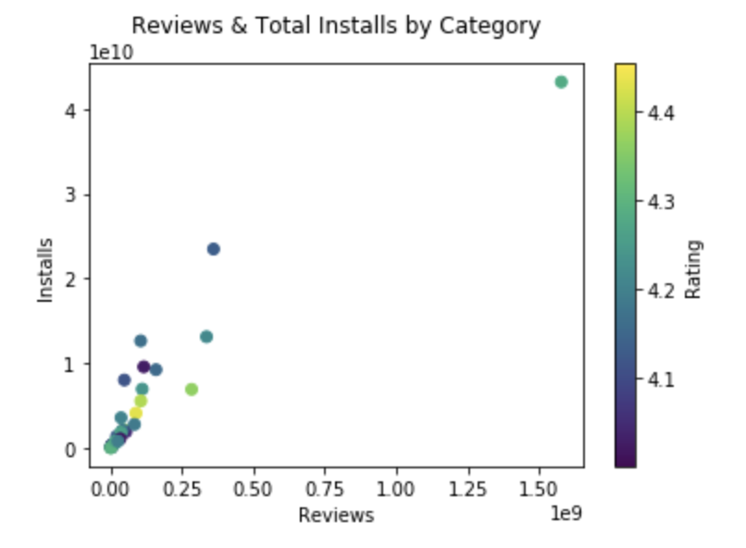
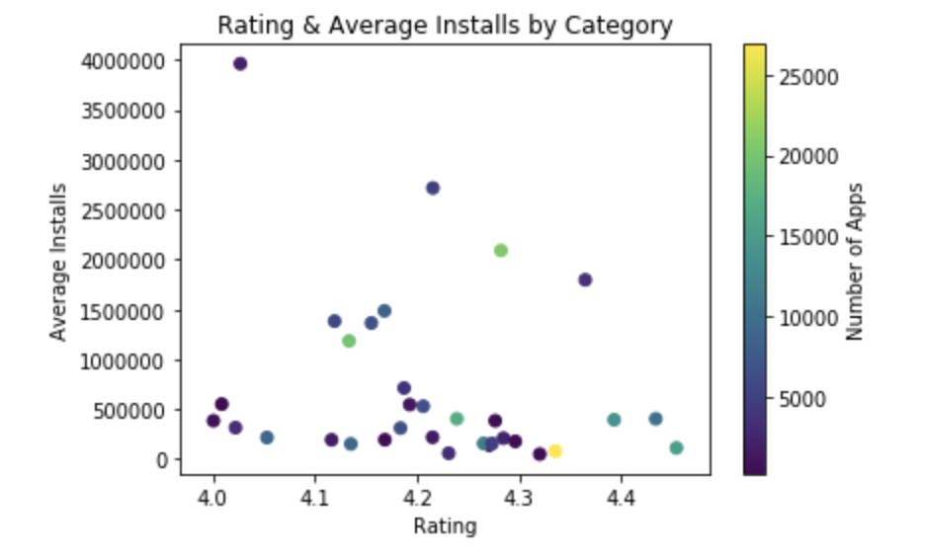
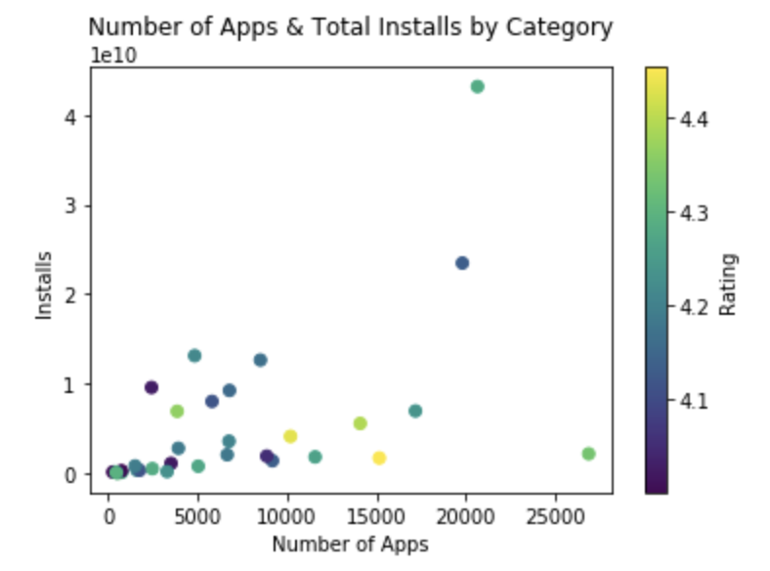
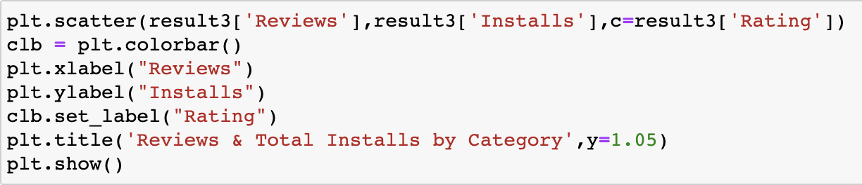
Data Analysis - By Category

Slide 7
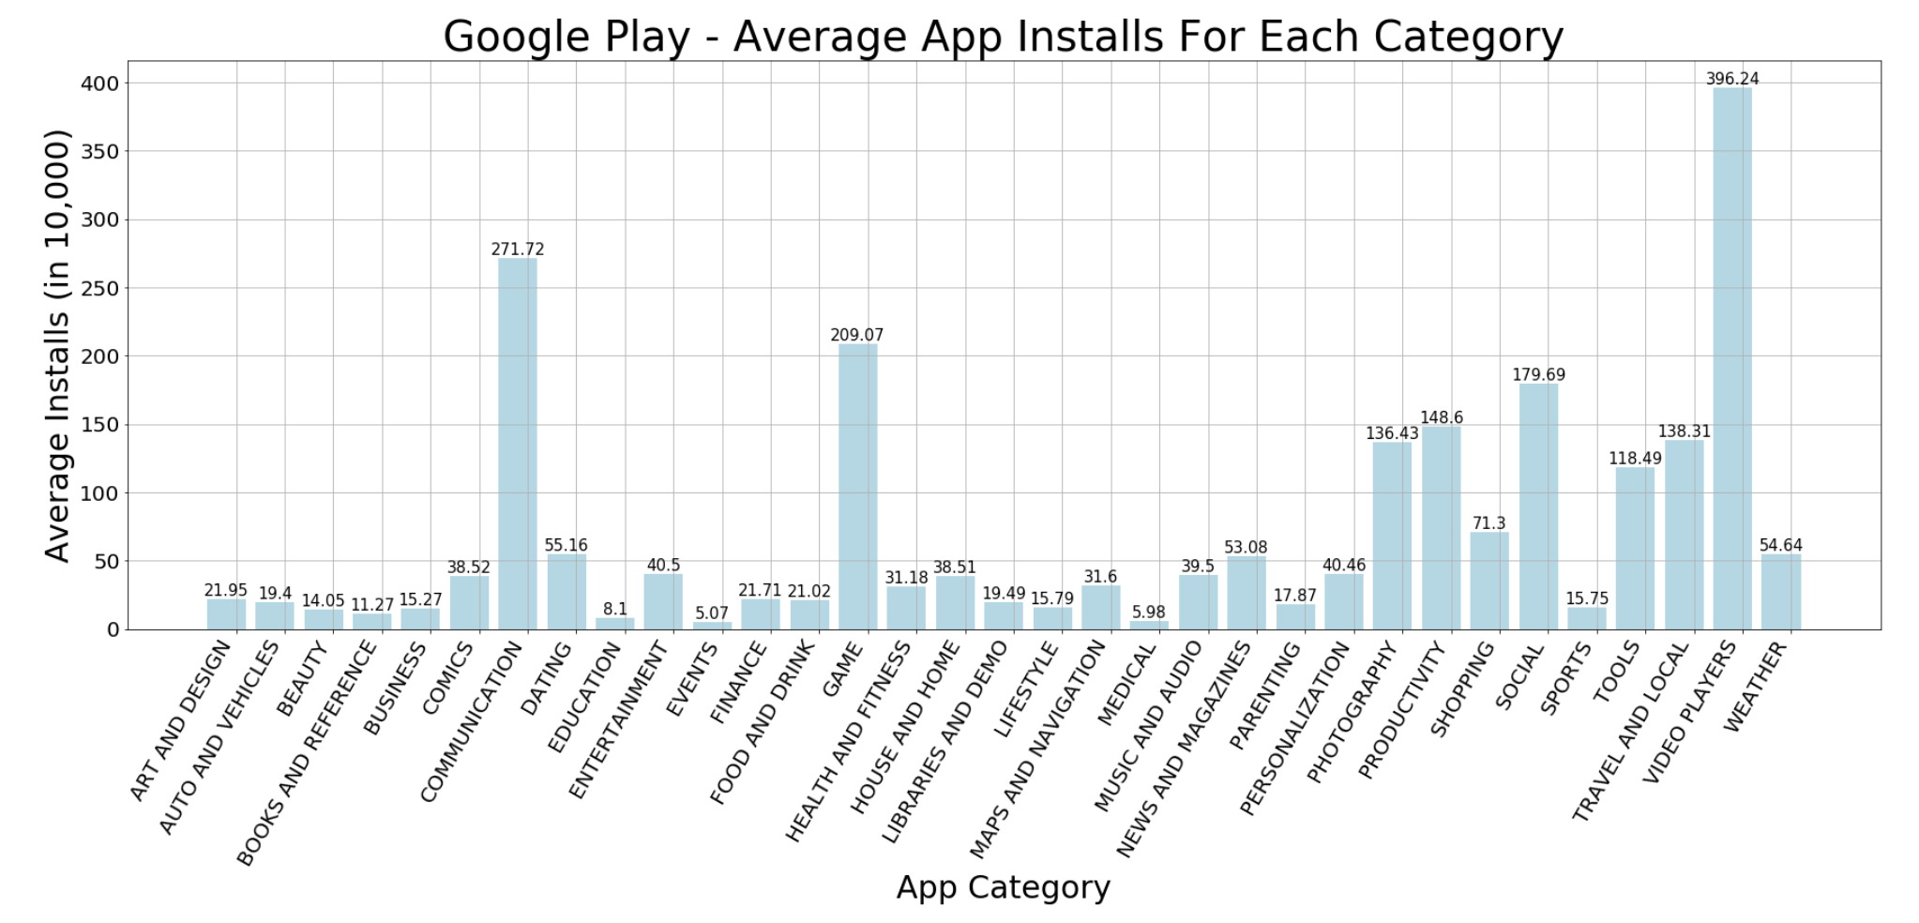
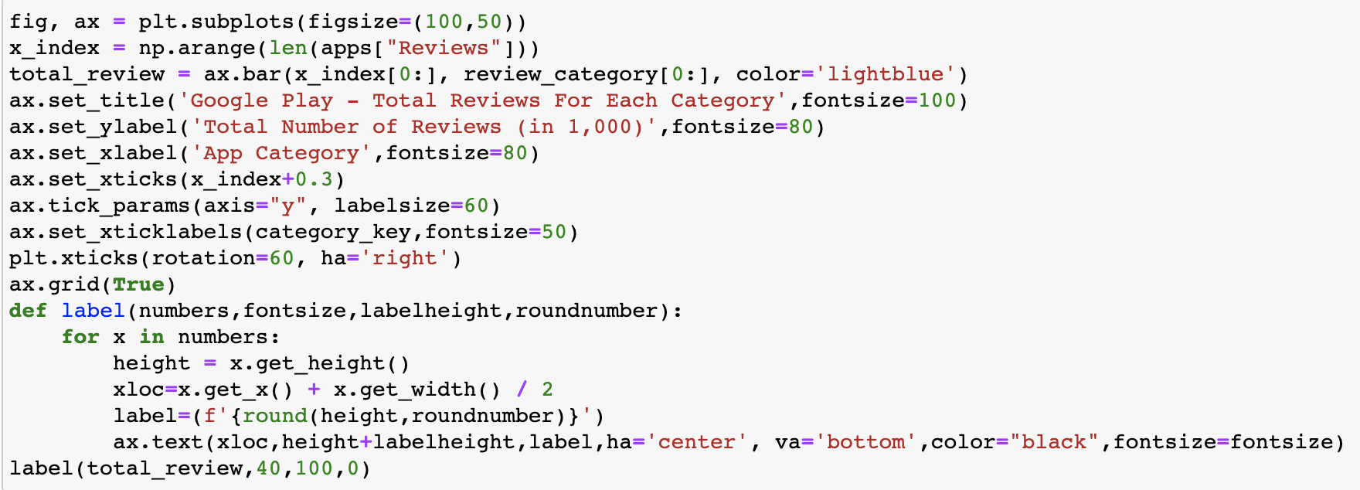
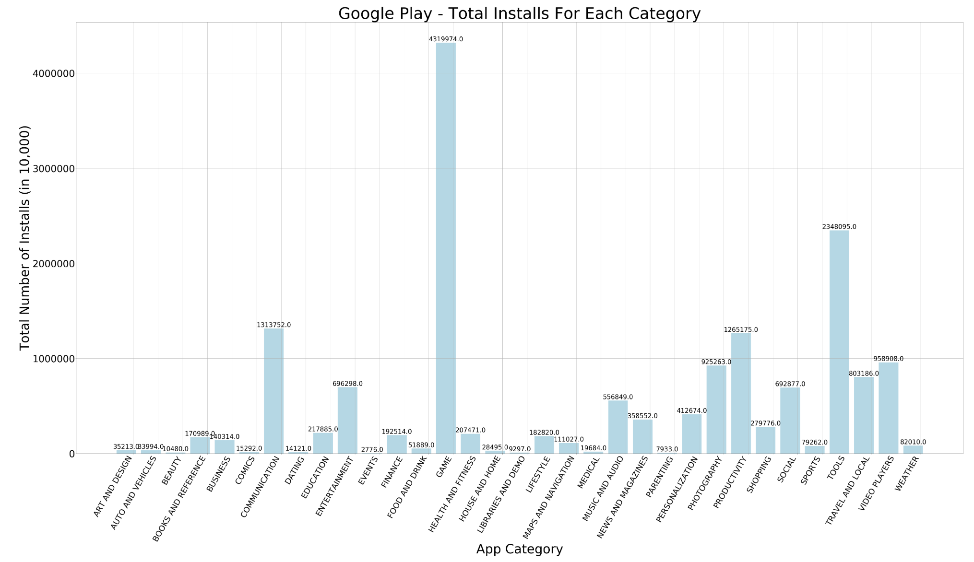
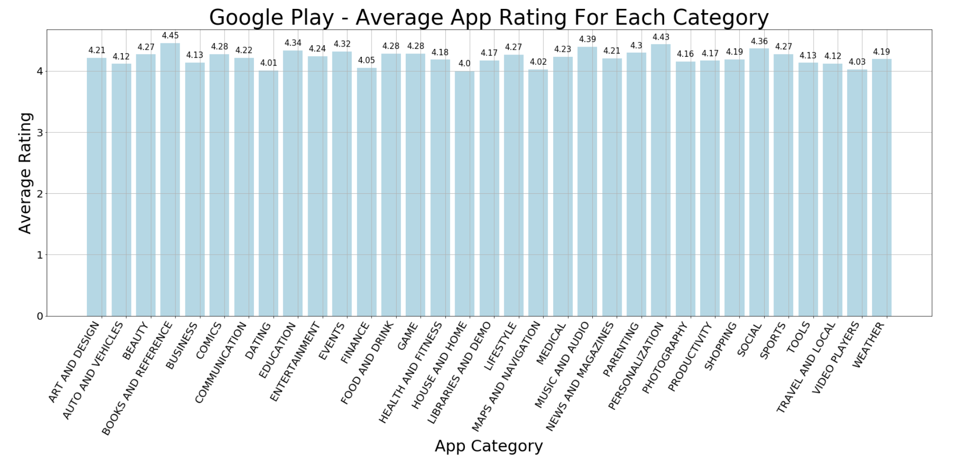

Slide 8
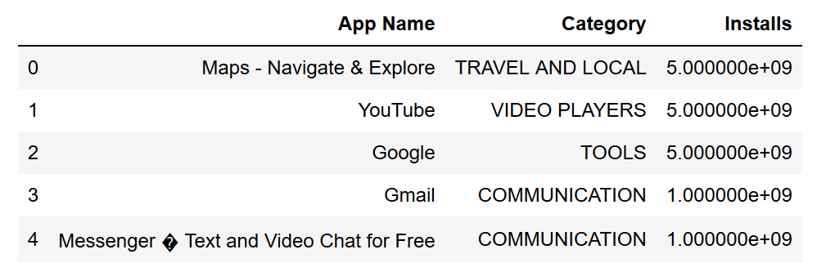
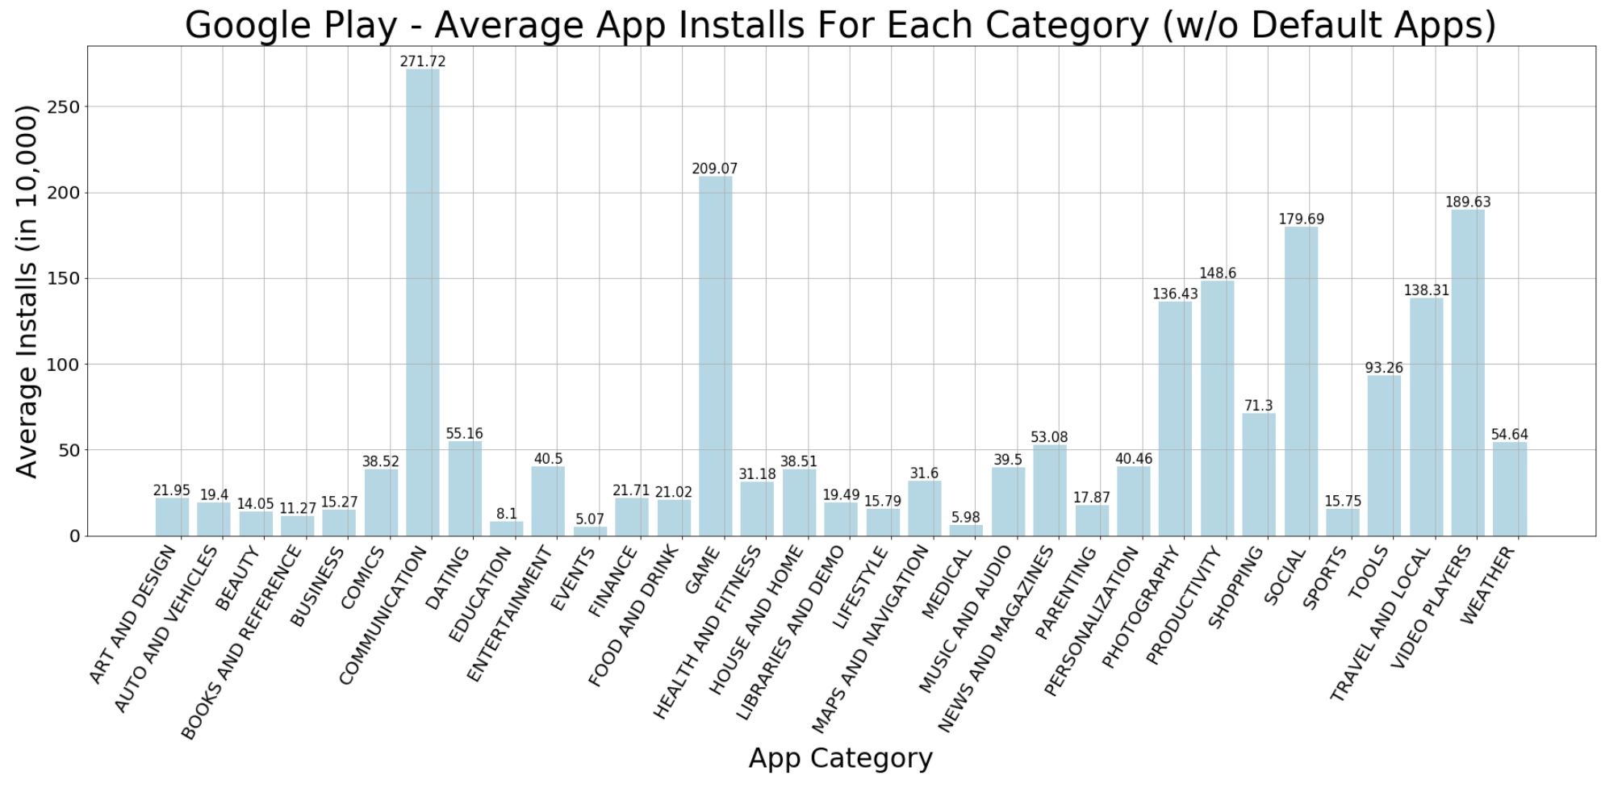
Video Players
Communication
Game
After removing pre-installed apps:

Slide 9
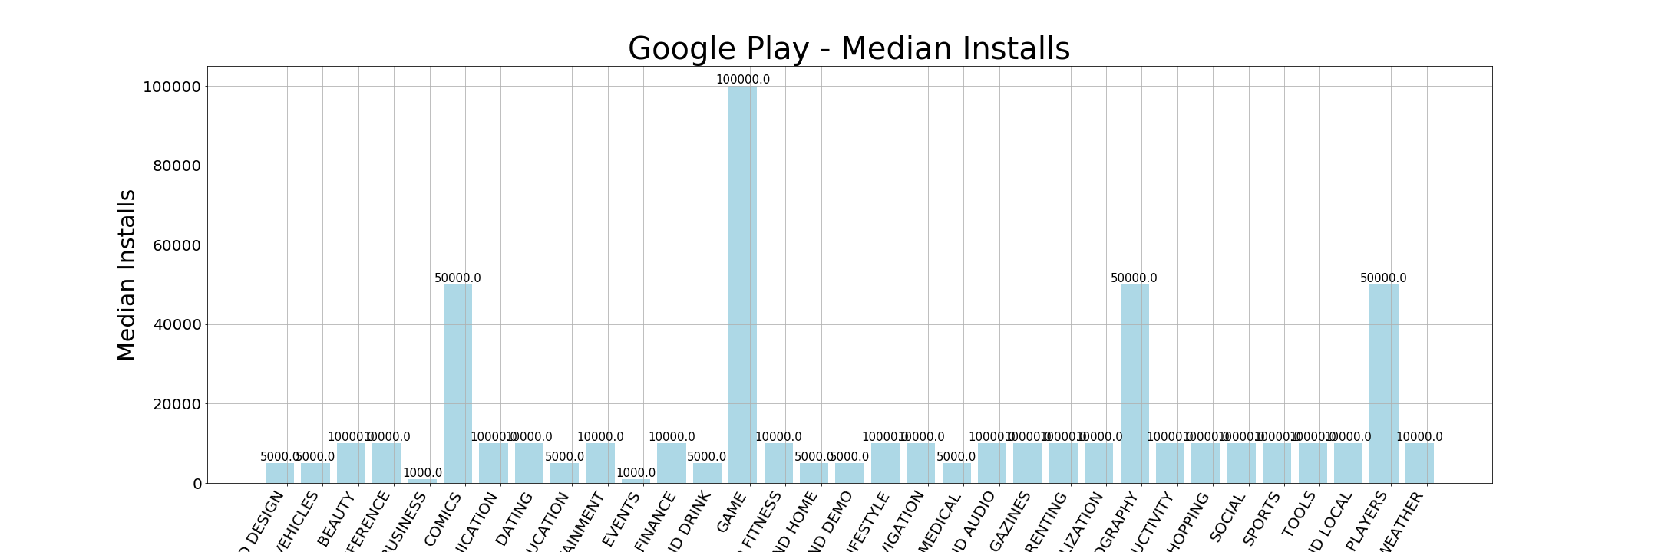
Communication
(10,000)
Game
(100,000)
Game Category
Highest total installs
Highest total reviews
2nd highest average installs
Highest median installs

Slide 10
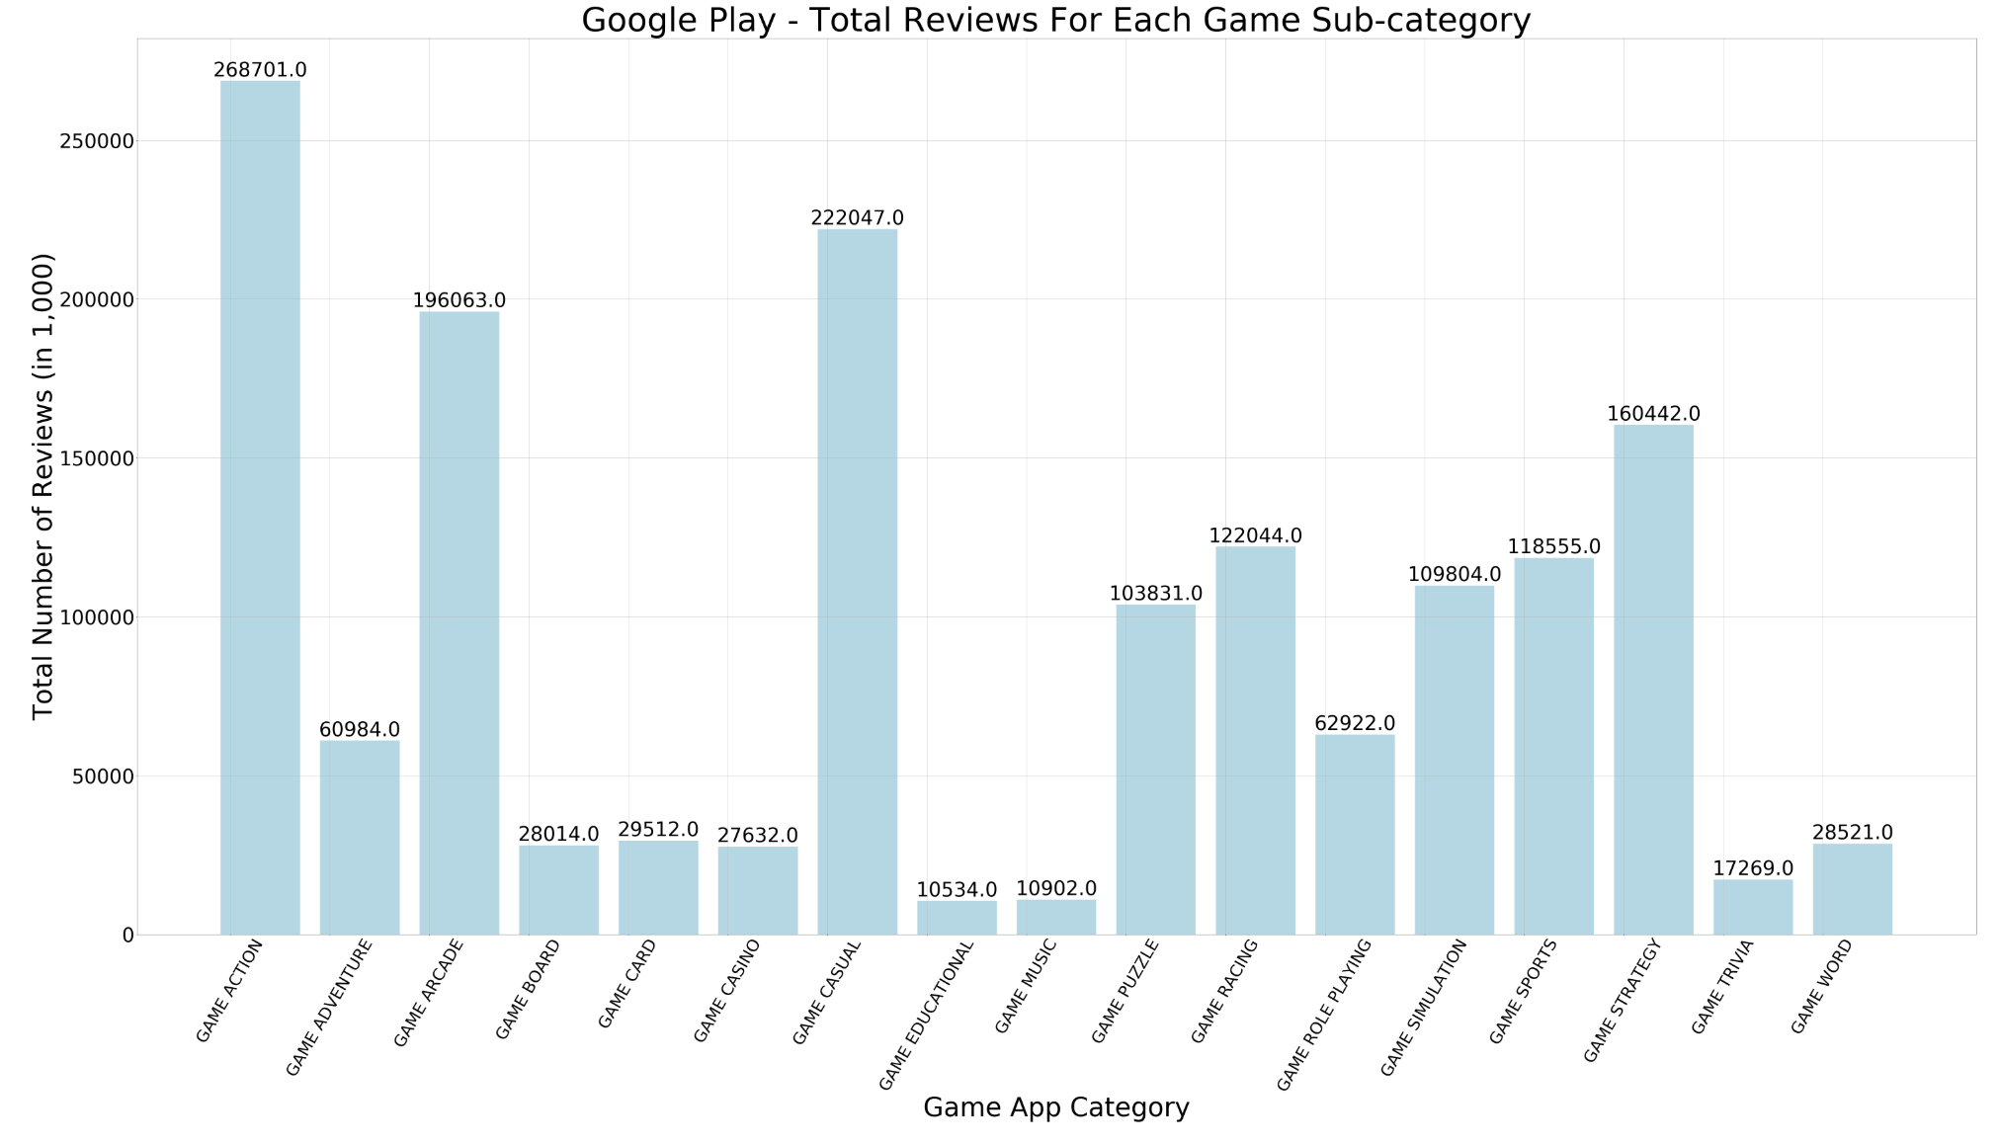
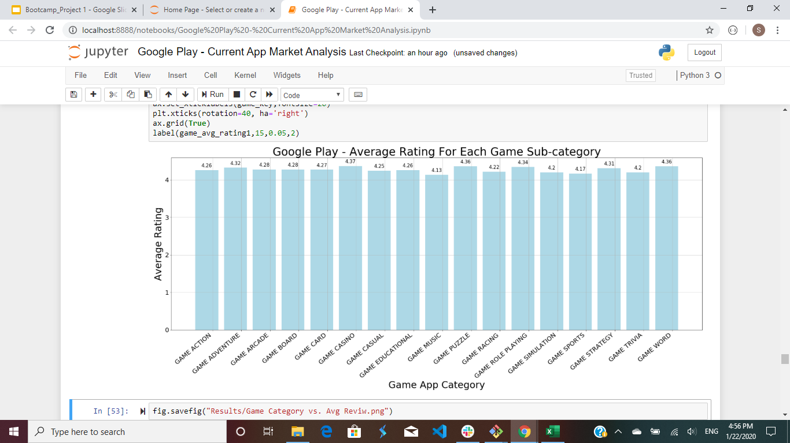
Data Analysis Con’t- By Game Sub-category
Action
Arcade
Casual

Slide 11
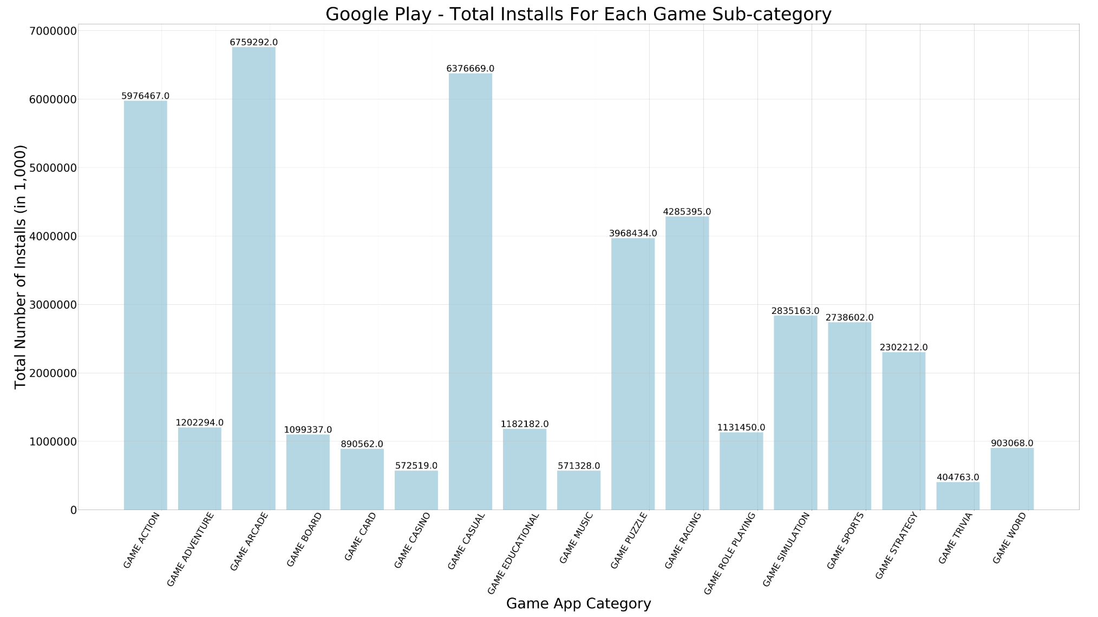
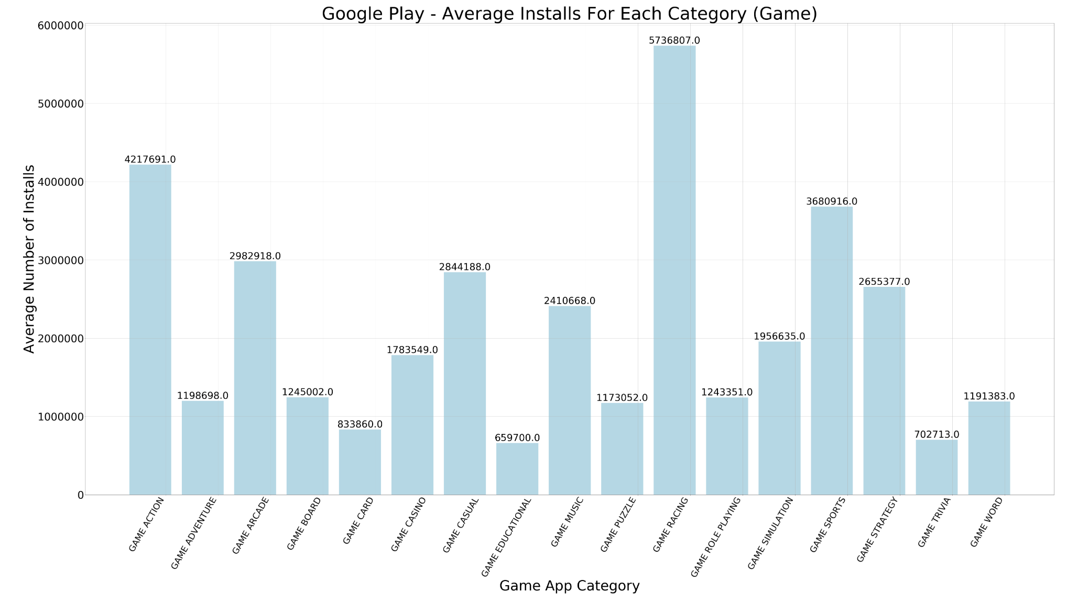
Action
Arcade
Casual
Action
Racing
Sports

Slide 12
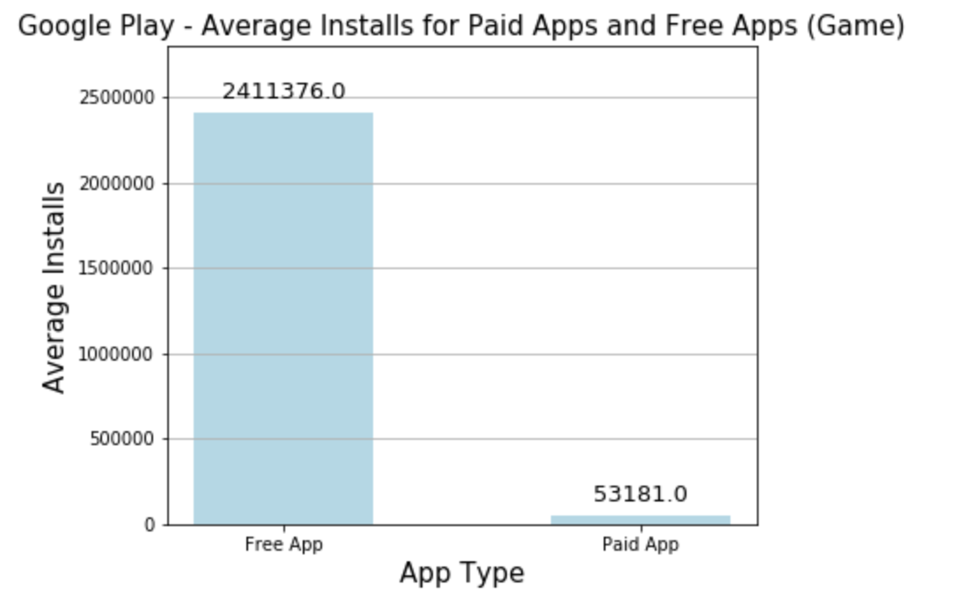
Free games: Dominating

Slide 13
Conclusion
App Type: FREE!
Preferred Category: Game
Sub-category: Racing (Highest Average install)
Strategy: Incentivise users to write a review in App store

Slide 14
Further Discussion
Analyze other categories
Compare apps by region
Compare with the Apple Store API
Compare data for multiple years, predict trends

Slide 15
Questions?

